Slide 1
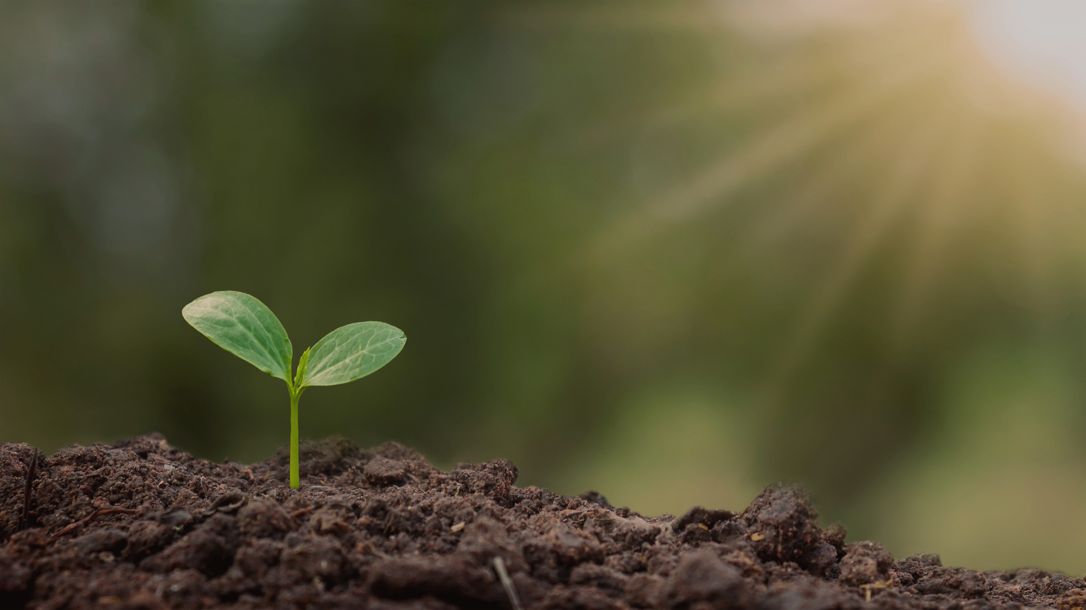

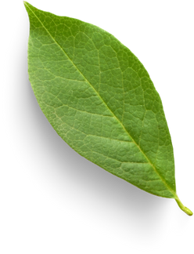
Releaf
Greening Our World Together
Supervisor by :
Dr. Reem Eldeeb
Eng. Hassan Khaled

Slide 2
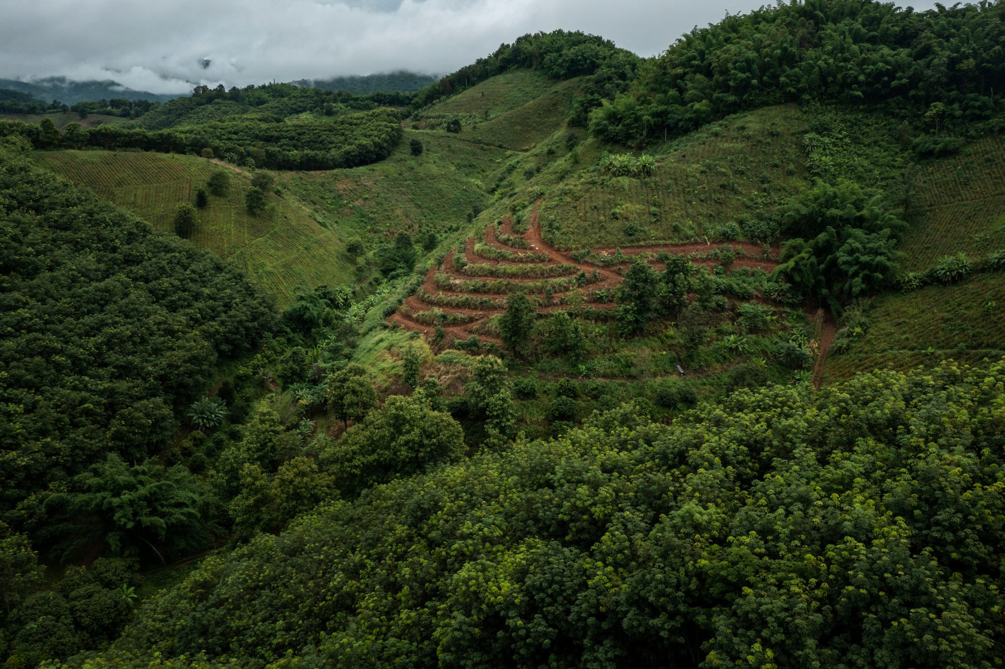

RELEAF
TABLE OF CONTENT
1
PROBLEM OVERVIEW
4
DIAGRAMS
2
PROJECT Objectives
5
TOOLS & TECHNIQUES
3
RELATED WORKS
6
UI DESIGN

Slide 3
RELEAF
1
PROBLEM
OVERVIEW
What is the problem we are trying to solve?

Slide 4
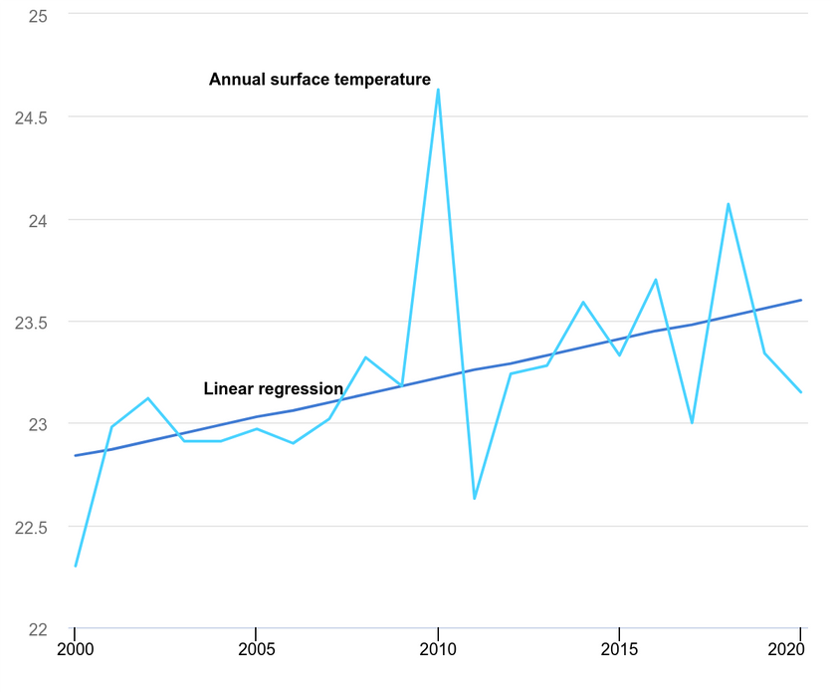
RELEAF
THE CHANGE IN GLOBAL SURFACE TEMPERATURES
Egypt’s temperature rose by 0.1°C per decade from 1901 to 2013, then increased to 0.38°C per decade from 2000 to 2020, exceeding the global average of 0.31°C.
By 2081-2100, temperatures could rise by 2.5°C with low emissions or 6°C with high emissions, leading to more extreme heat due to urbanization and population growth.

Slide 5
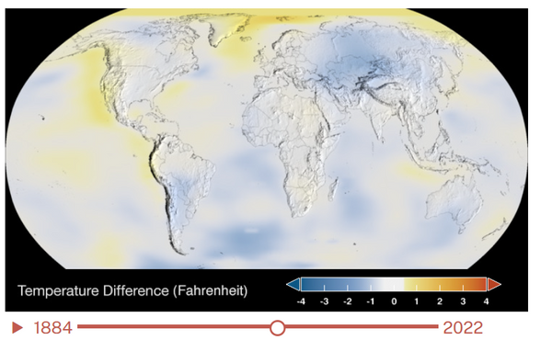
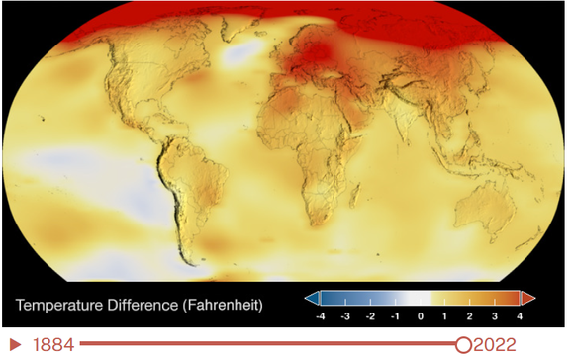
RELEAF
THE CHANGE IN GLOBAL SURFACE TEMPERATURES
2000
2022
DARK BLUE SHOWS AREAS COOLER THAN AVERAGE. DARK RED SHOWS AREAS WARMER THAN AVERAGE. SHORT-TERM VARIATIONS ARE SMOOTHED OUT USING A 5-YEAR RUNNING AVERAGE TO MAKE TRENDS MORE VISIBLE IN THIS MAP.

Slide 6
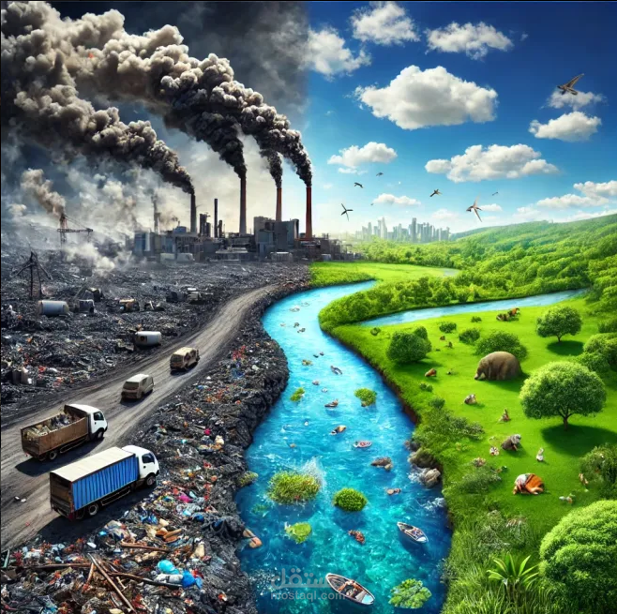
RELEAF
PROBLEM DEFINITION
Urbanization and industrial activities have reduced green spaces and increased pollution in Egypt.
This has led to urban heat islands, poor air quality, and biodiversity loss.
Despite growing awareness, afforestation efforts are limited by inadequate tools and resources.

Slide 7
RELEAF
2
PROJECT
OBJECTIVES
What is the main goal we aim for?

Slide 8
RELEAF
WHY WE CHOSE THIS PROBLEM?
Green spaces are vital, but Egypt’s urban areas suffer from pollution, heat, and little greenery.
Tree planting improves air, reduces heat, and boosts well-being, but awareness is low.
Despite these benefits, awareness and participation in tree-planting initiatives remain low.
This supports a greener, sustainable future for Egypt.

Slide 9



RELEAF
OUR FEATURES
Interactive planting maps to show areas needing greenery or where trees are already planted.
Guidance for home gardening to encourage urban greenery.
recognizing and naming a plant species.

Slide 10


RELEAF
OUR FEATURES
identifying diseases affecting plants based on visible symptoms.
Community participation through volunteering and donations.

Slide 11
RELEAF
3
RELATED WORKS
This section shows that you’ve researched similar projects and that your app offers unique improvements.

Slide 12


RELEAF
FEATURES
HOME AGRICULTURE AND GARDENING TIPS
INTERACTIVE PLANTING MAPS
EDUCATION AND GUIDANCE
AI POWERED PLANT IDENTIFICATIONS
DONATIONS
VOLUNTEERING
PlanNet | TreePlant | Picture This | Garden Tags | Our Applications

Slide 13
RELEAF
4
DIAGRAMS
In which flow we go?

Slide 14
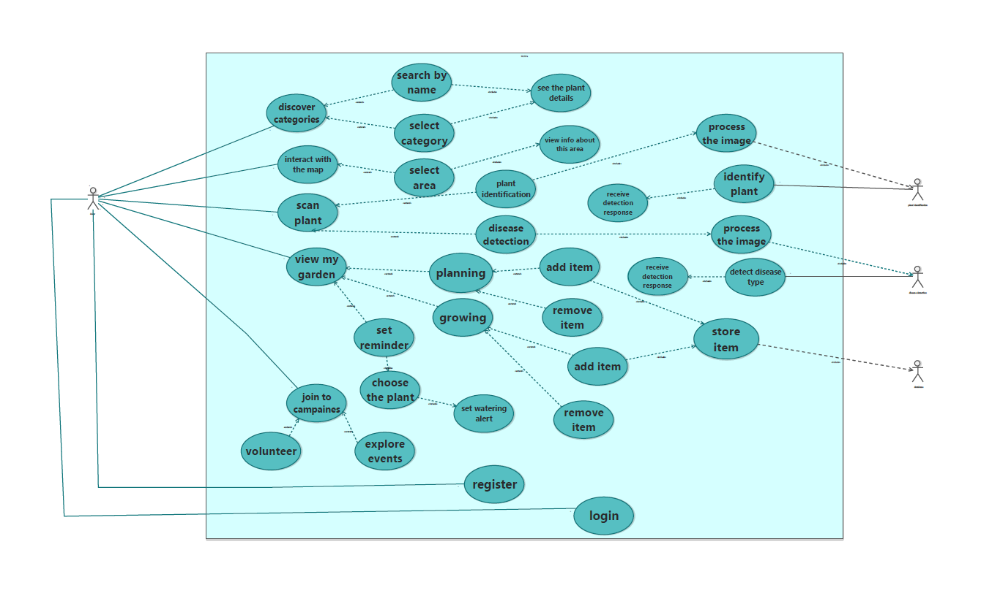
RELEAF
UML DIAGRAM
USE CASE

Slide 15
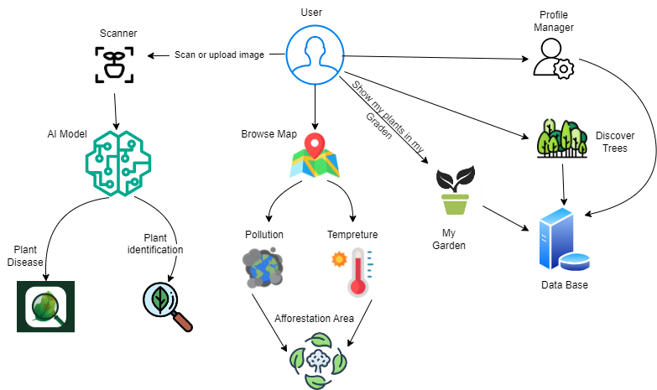
RELEAF
ARCHITECTURAL DIAGRAM

Slide 16
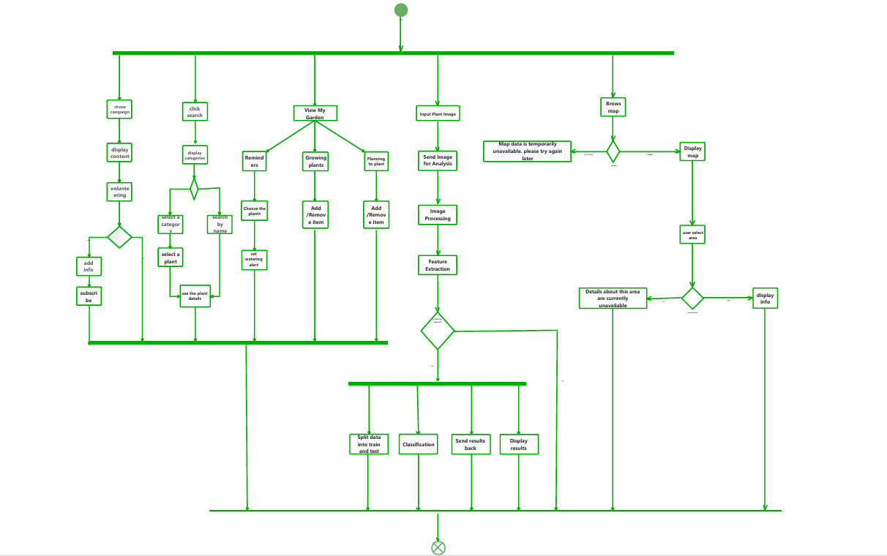
RELEAF
UML DIAGRAM
AVTIVITY DIAGRAM
ACTIVITY

Slide 17
RELEAF
Key Partners | Key Activities | Value Proposition | Customer Relationships | Customer segments
Local Authorities like: Ministry of Environment. Environment-Focused Businesses. Environmental organizations promoting sustainability. Beginner and seasoned gardeners. Homeowners with gardens, balconies, or rooftop spaces. | App development and maintaining. Environmental Data Analysis. AI Integration. Marketing and Partnerships. | Promotes tree planting to increase green spaces and fight climate change. Educates users on trees care and tracks contributions. Encourages community participation through campaigns Provides an interactive map to highlight the characteristics of area to determine whether it is suitable for afforestation or not. AI-driven plant identification and health diagnosis (using images). | Automated Relationships. Personal Relationships. | People who want to plant at home and take care of trees People who care about trees and want to make the environment greener. Environmentally aware individuals and families. gardeners, gardenowners. Organizations dedicated to sustainability and the advancement of eco-friendly projects.
Local Authorities like: Ministry of Environment. Environment-Focused Businesses. Environmental organizations promoting sustainability. Beginner and seasoned gardeners. Homeowners with gardens, balconies, or rooftop spaces. | Key Resources | Promotes tree planting to increase green spaces and fight climate change. Educates users on trees care and tracks contributions. Encourages community participation through campaigns Provides an interactive map to highlight the characteristics of area to determine whether it is suitable for afforestation or not. AI-driven plant identification and health diagnosis (using images). | Channels | People who want to plant at home and take care of trees People who care about trees and want to make the environment greener. Environmentally aware individuals and families. gardeners, gardenowners. Organizations dedicated to sustainability and the advancement of eco-friendly projects.
Local Authorities like: Ministry of Environment. Environment-Focused Businesses. Environmental organizations promoting sustainability. Beginner and seasoned gardeners. Homeowners with gardens, balconies, or rooftop spaces. | Development Team: For app. Mapping Tools: APIs like Google Maps. Data collection and AI training for plant identification and health diagnosis. Secure and scalable cloud infrastructure. | Promotes tree planting to increase green spaces and fight climate change. Educates users on trees care and tracks contributions. Encourages community participation through campaigns Provides an interactive map to highlight the characteristics of area to determine whether it is suitable for afforestation or not. AI-driven plant identification and health diagnosis (using images). | App Stores. Social Media. Campaigns. | People who want to plant at home and take care of trees People who care about trees and want to make the environment greener. Environmentally aware individuals and families. gardeners, gardenowners. Organizations dedicated to sustainability and the advancement of eco-friendly projects.
BUSINESS MODEL CANVAS
Cost Structure | Revenue Streams
App development and updates. AI model training and maintenance. Marketing. Hosting and maintenance costs. Campaigns costs. | Subscriptions for advanced features. Sponsorships through campaigns. Seed and seedling store.

Slide 18
RELEAF
5
TOOLS & TECHNIQUES
What did we use to build our project?

Slide 19




RELEAF
FLUTTER
STATE MANAGEMENT
DESIGN PATTERN
UI DESIGN
Bloc ( Cubit )
MVVM
Architecture
Responsive

Slide 20


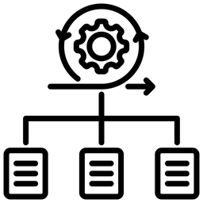
RELEAF
BACKEND SERVICES
Database & Storage
.NET Core
Framework
SQL Server Relational database for structured data management.
.NET Core (C#) – Robust and scalable backend framework for API development.
ASP.NET Web API – To create secure and efficient RESTful APIs.
Entity Framework Core – ORM for seamless
database interactions

Slide 21
RELEAF
AI
Plant Identification
Plant Disease
recognizing and naming a plant species based on its characteristics, such as leaf shape, flower structure
identifying diseases affecting plants based on visible symptoms such as leaf spots, discoloration, wilting, mold growth, and abnormal growth patterns.

Slide 22
RELEAF
6
UI DESIGN
How we look?

Slide 23

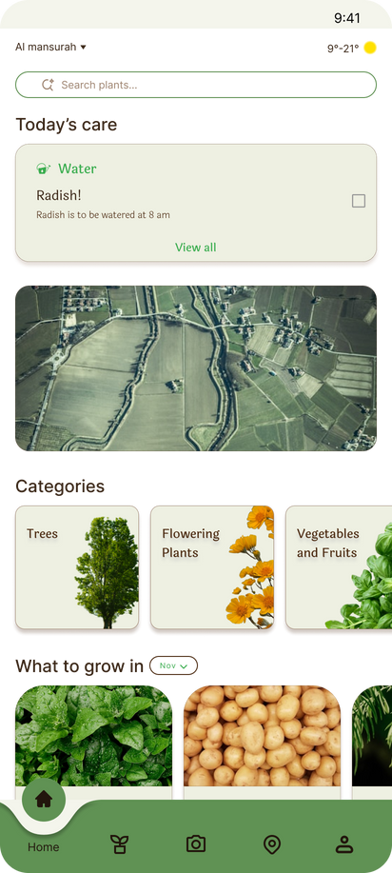
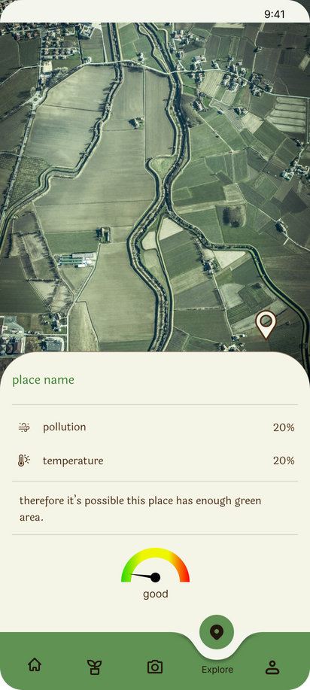
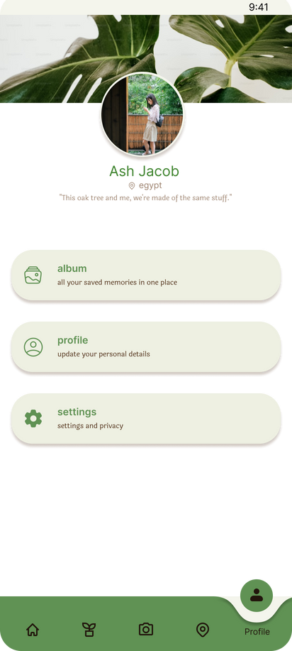
RELEAF
UI DESIGN

Slide 24
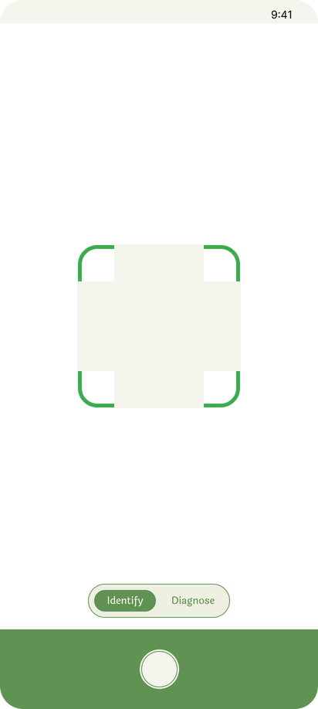
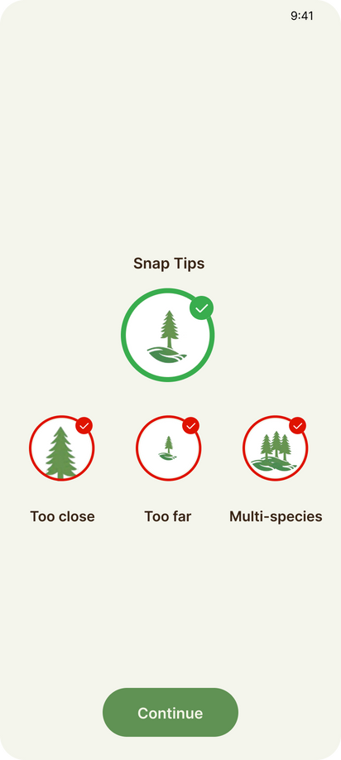
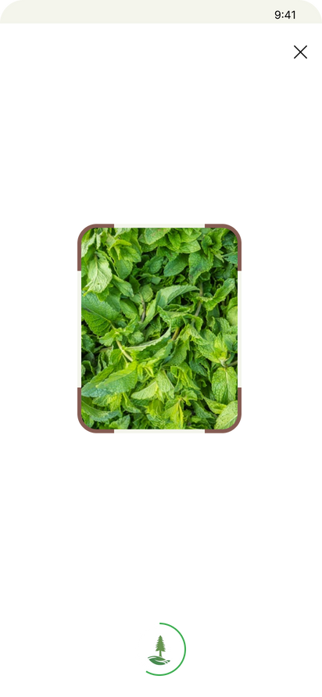
RELEAF
UI DESIGN

Slide 25
THANKS!
ANY QUESTIONS?

